Slide 1



Arowwai Industrie
GREEN ENERGY
Powering Industries with Renewable Energy Advancements
Presented by: Adora Montminy

Slide 2

WHY GREEN ENERGY MATTERS
Green energy matters because it offers a clean and sustainable alternative to traditional fossil fuels. By reducing greenhouse gas emissions, it mitigates climate change and promotes environmental health.

Slide 3
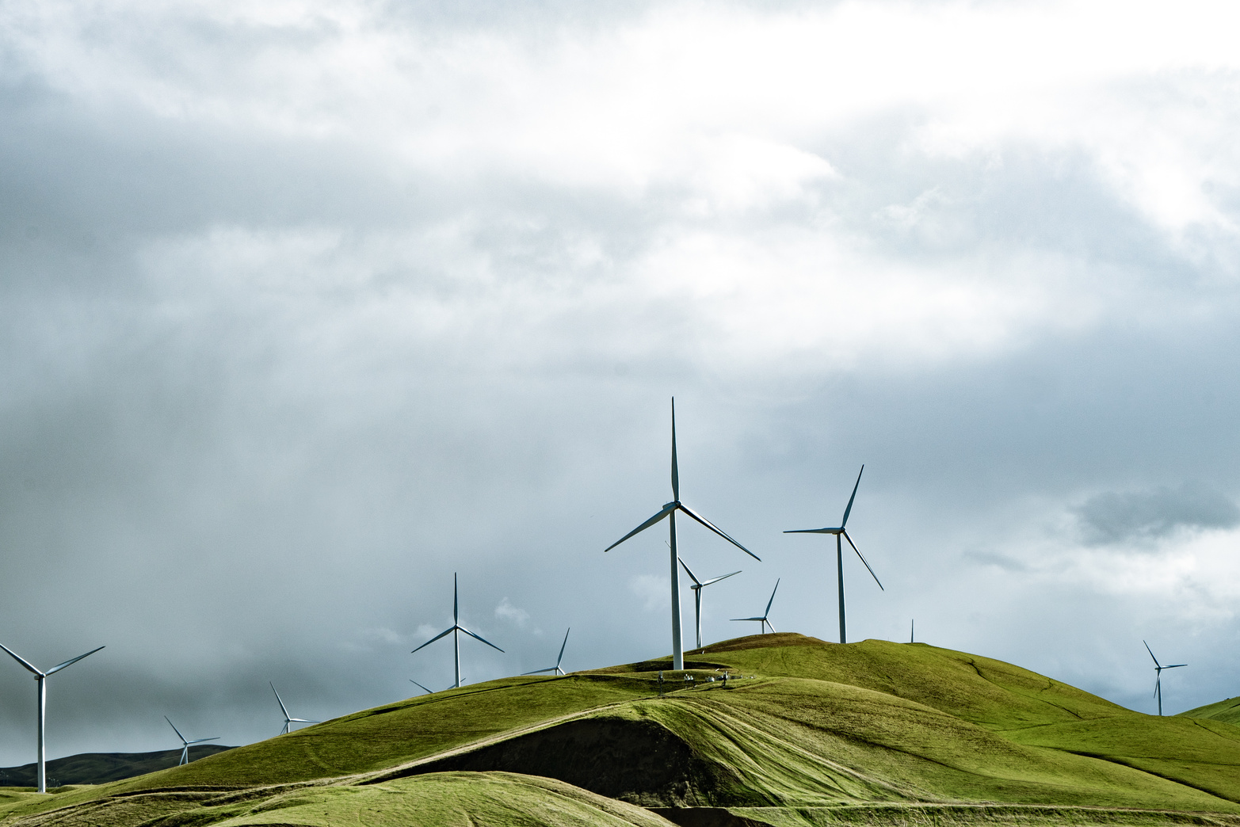
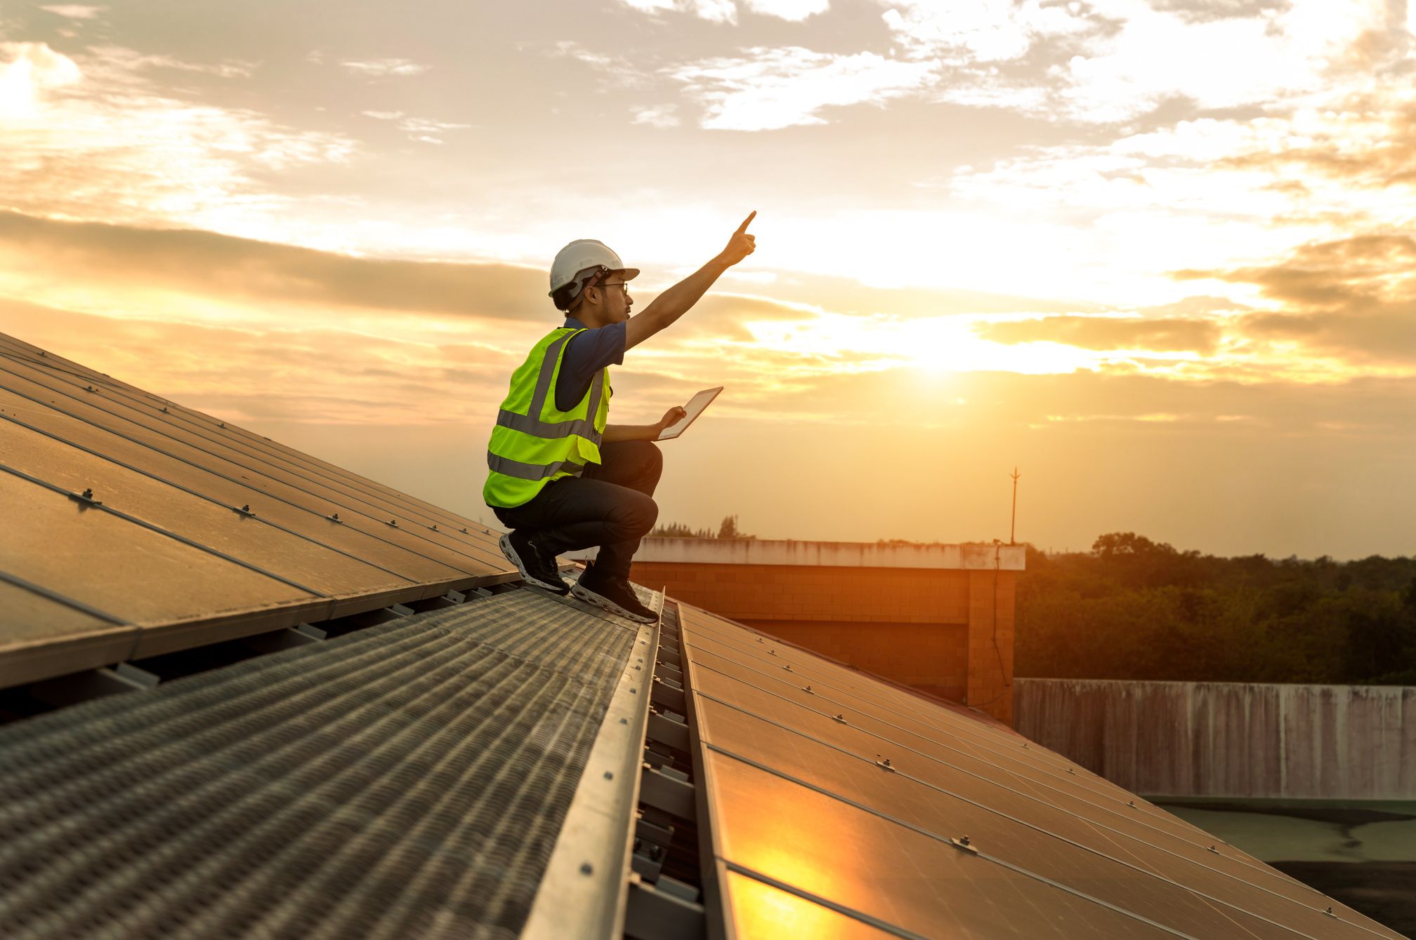
OUR COMMITMENT TO SUSTAINABILITY
We are dedicated to creating innovative energy solutions that balance environmental care, economic viability, and social impact, ensuring a greener planet for future generations.
Vision: To lead the transition to renewable energy.
Mission: Providing accessible, efficient, and sustainable energy solutions.

Slide 4
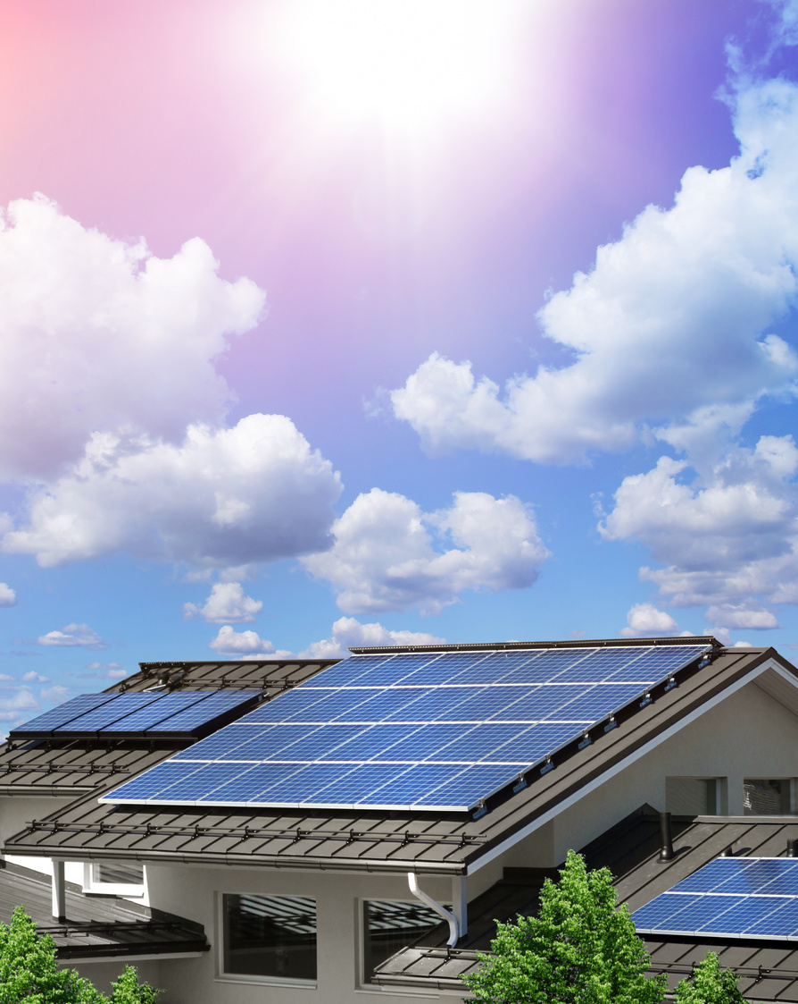
ADVANCED AND SUSTAINABLE SOLUTIONS
Solar power: Harnessing sunlight efficiently.
Wind energy: Leveraging wind for clean electricity.
Bioenergy: Turning waste into power.
Energy storage: Innovating battery technologies.
Solutions leverage modern technologies to maximize energy efficiency, minimize environmental impact, and ensure long-term viability for renewable energy systems.

Slide 5
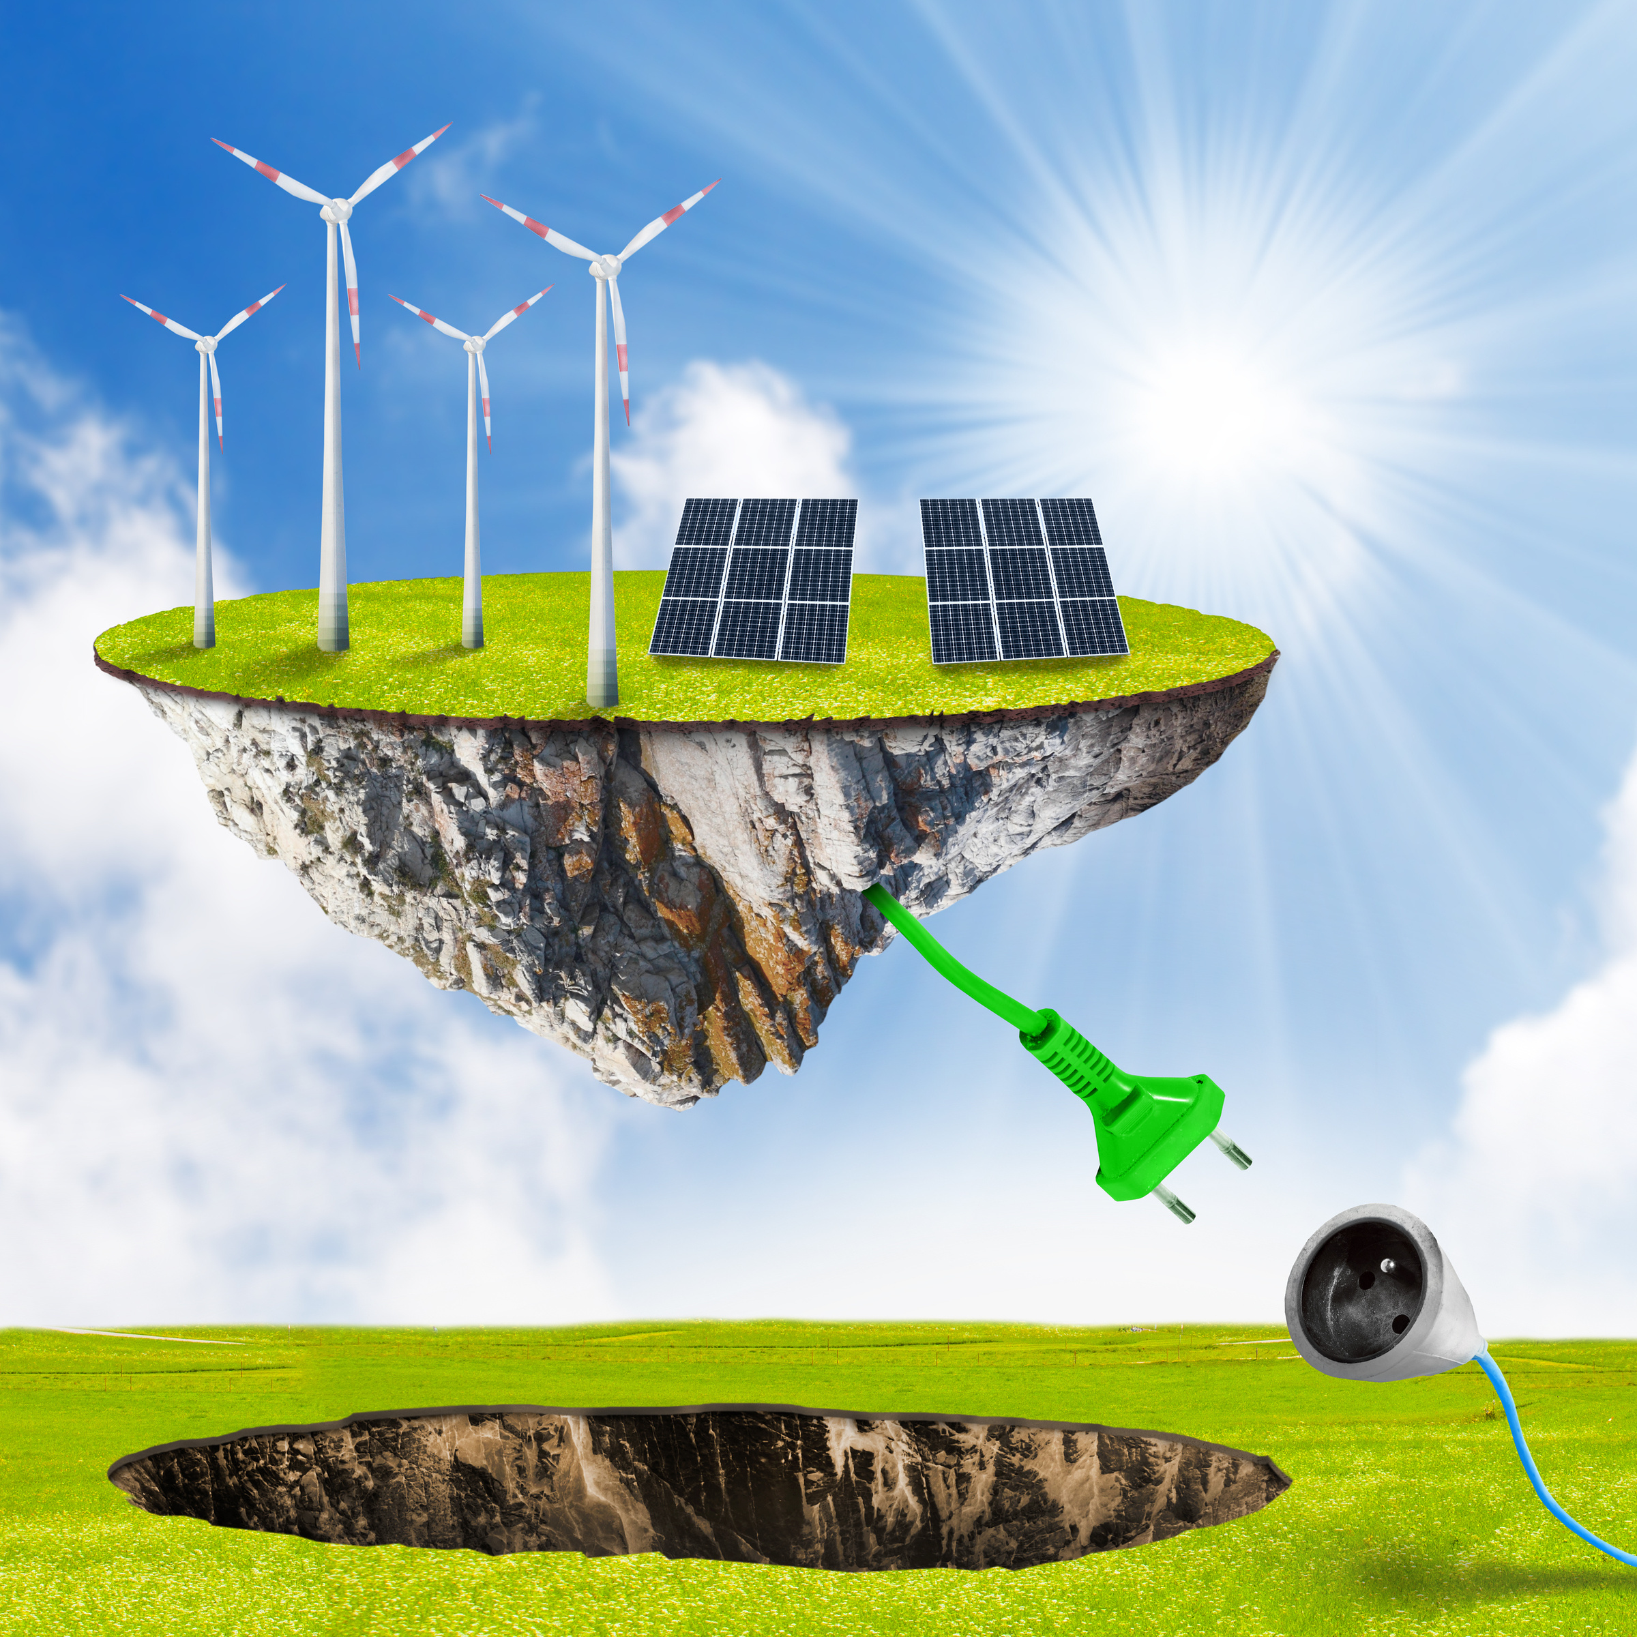
THE IMPACT OF GOING GREEN
Embracing green energy drives positive change by reducing pollution, fostering economic growth, and improving the quality of life for communities worldwide.
Environmental: Reduced greenhouse gas emissions.
Economic: Creating jobs in renewable energy sectors.
Social: Providing clean and affordable energy to communities.

Slide 6

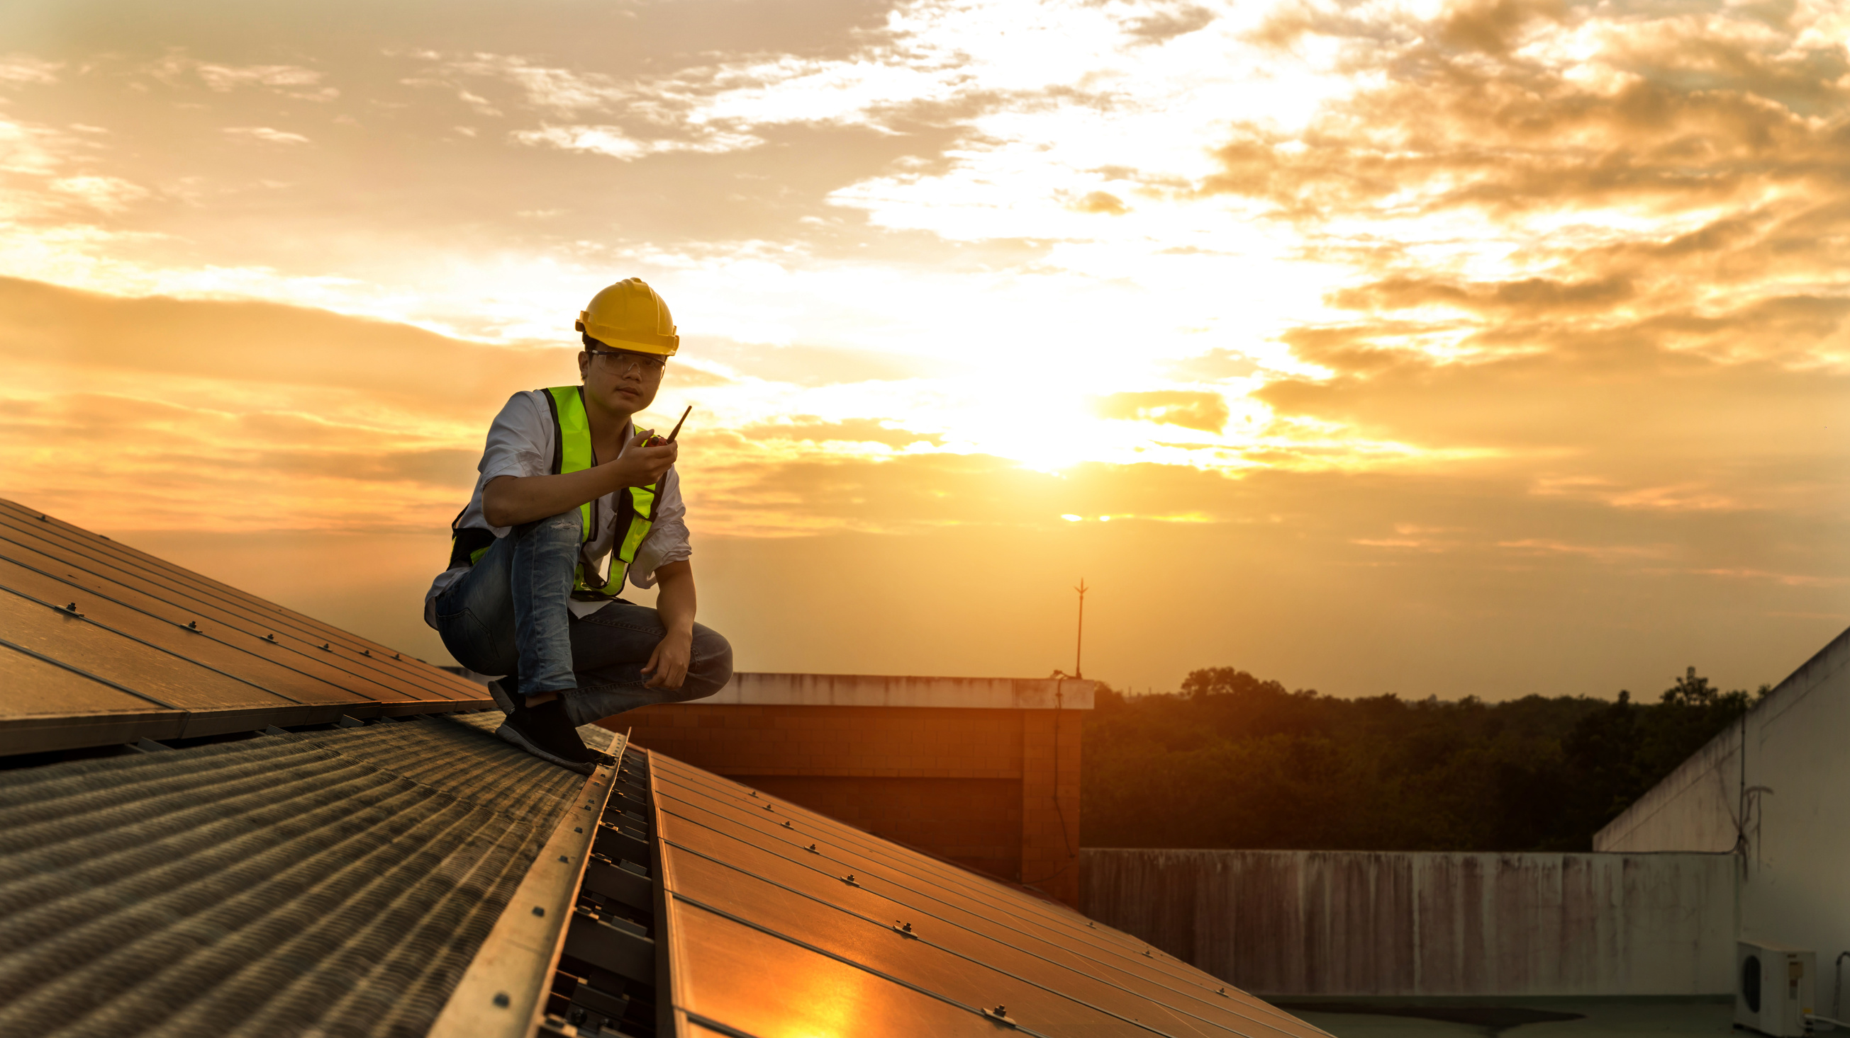


MILESTONES ACHIEVED
Highlight our success in implementing innovative green energy projects, demonstrating our commitment to creating a sustainable energy future.
Solar farms
10 MW installed in rural areas.
Wind turbine projects
Powering 50,000 homes.
Waste-to-energy initiatives
Reducing landfill dependence.

Slide 7

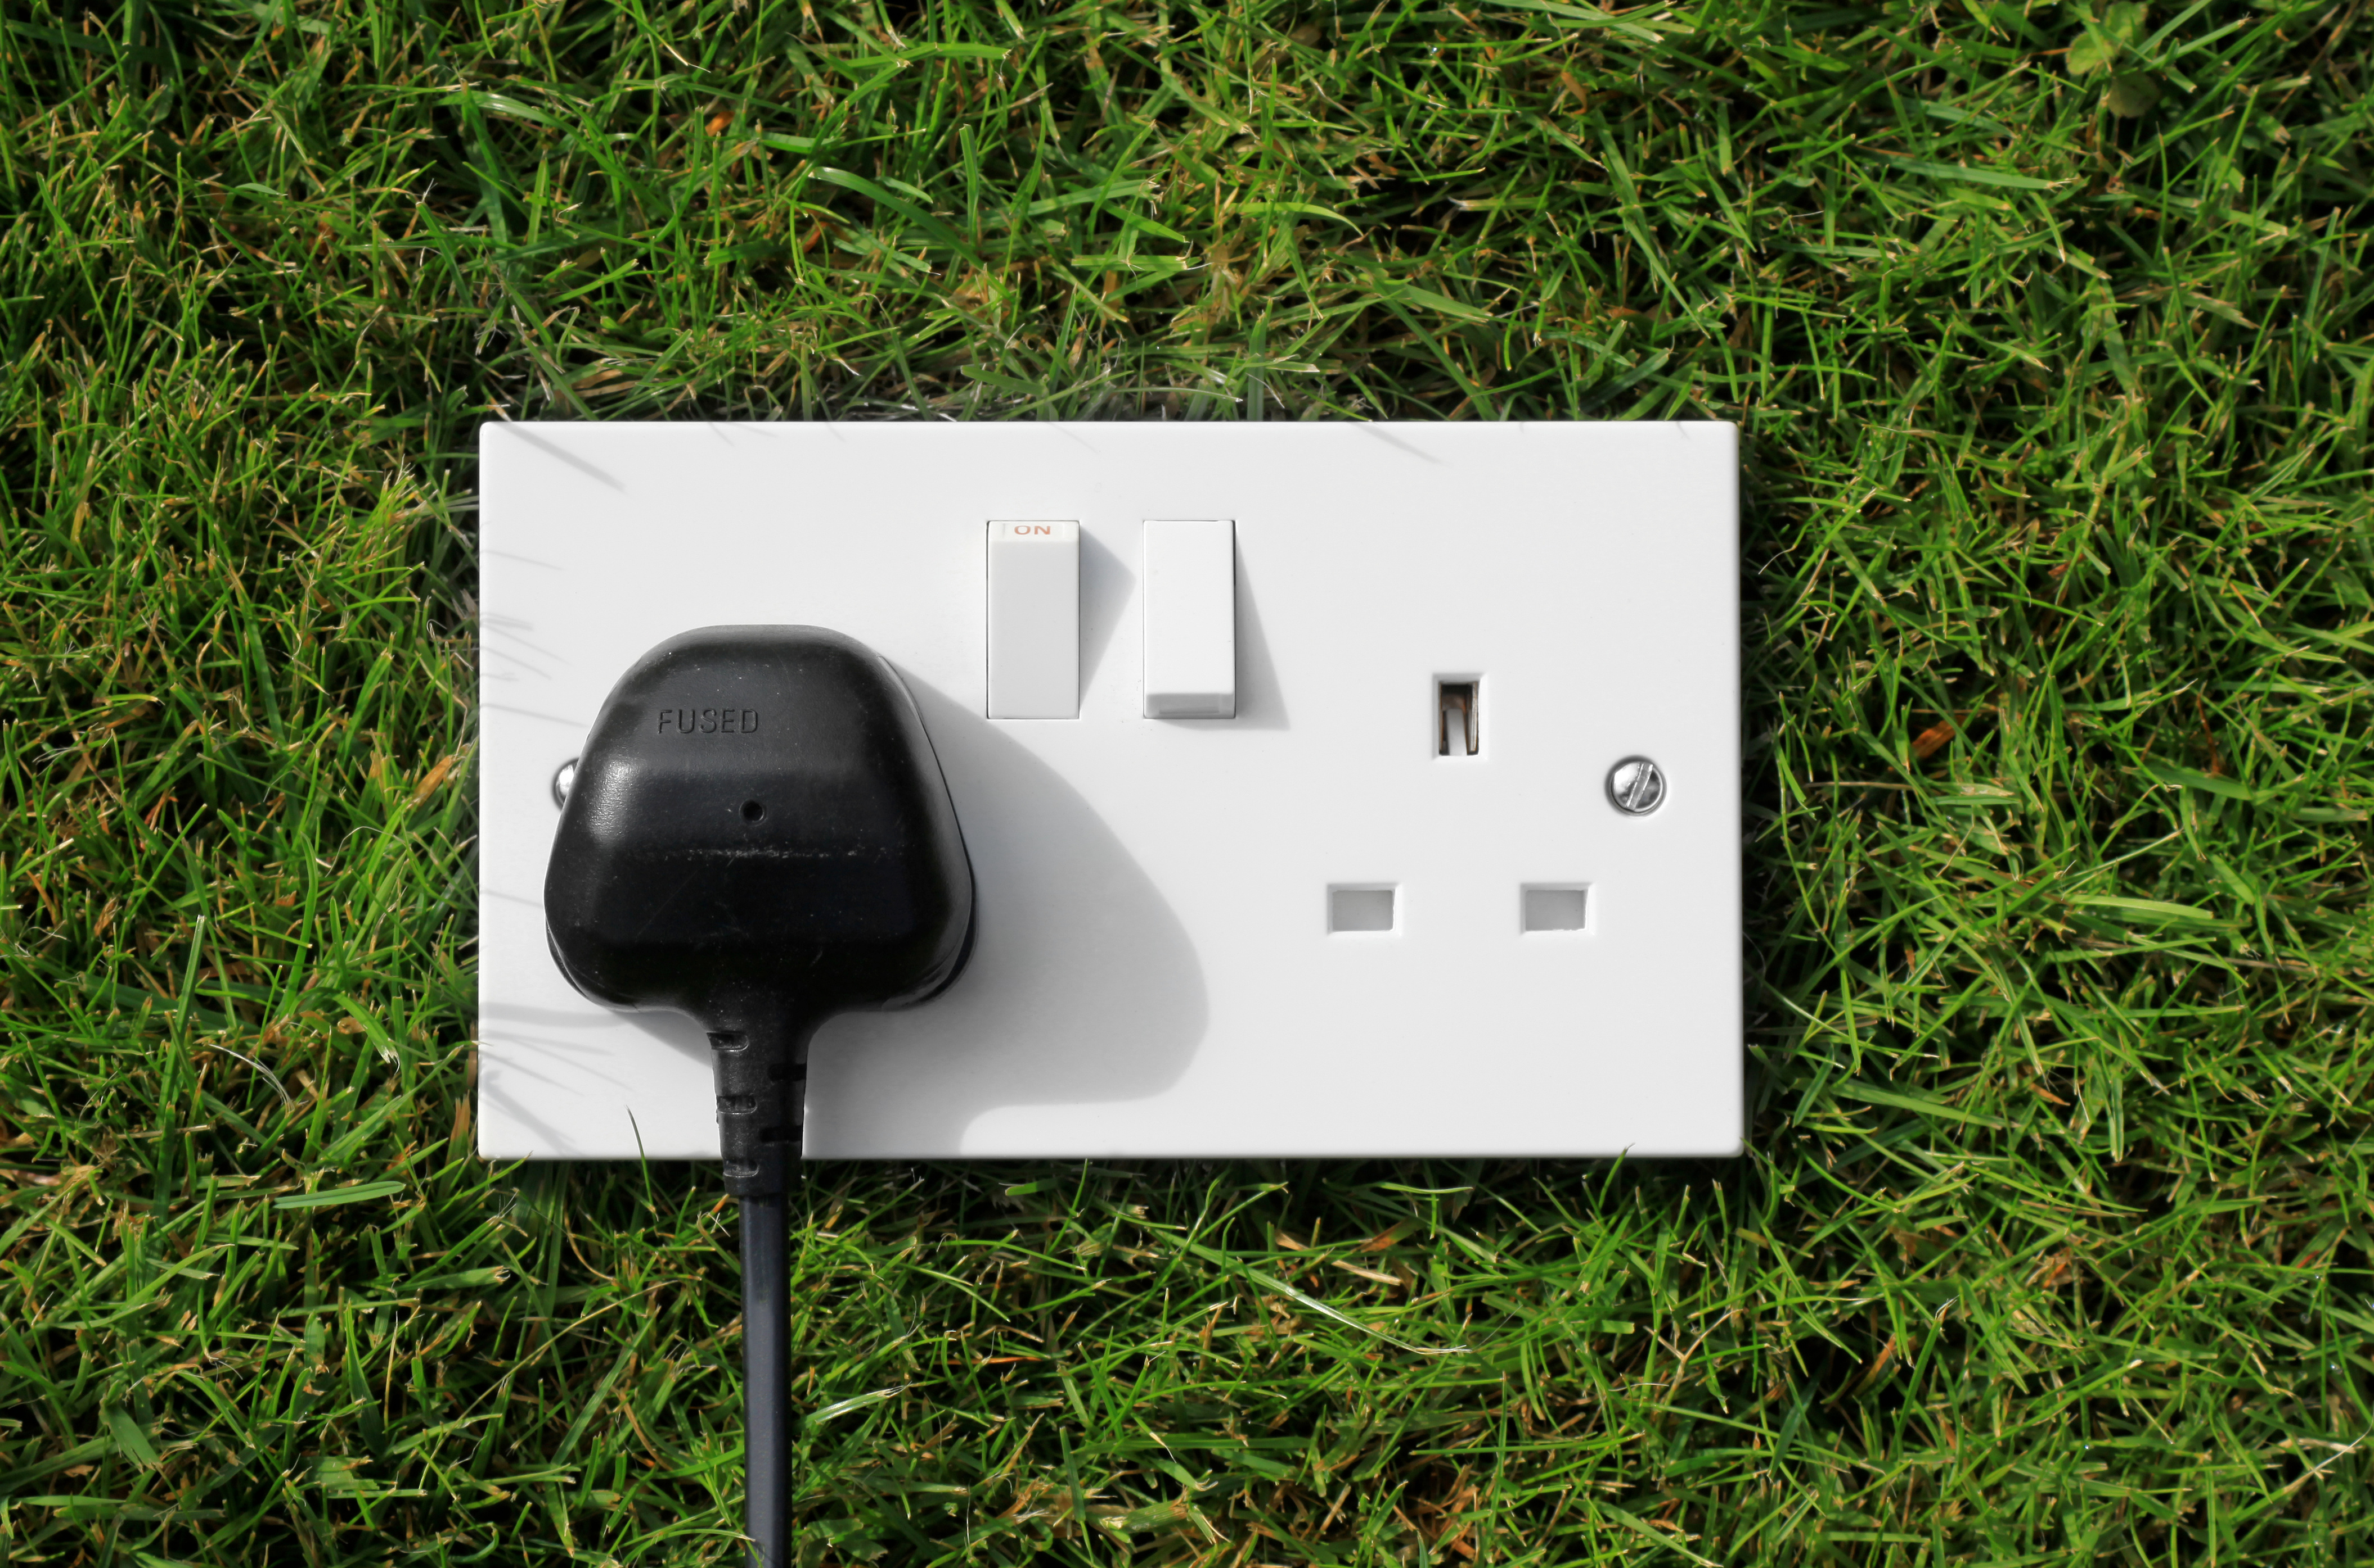
GREEN ENERGY GROWTH
Showcases the increasing global adoption of renewable technologies, emphasizing their role in reducing carbon emissions and advancing energy independence.

Slide 8
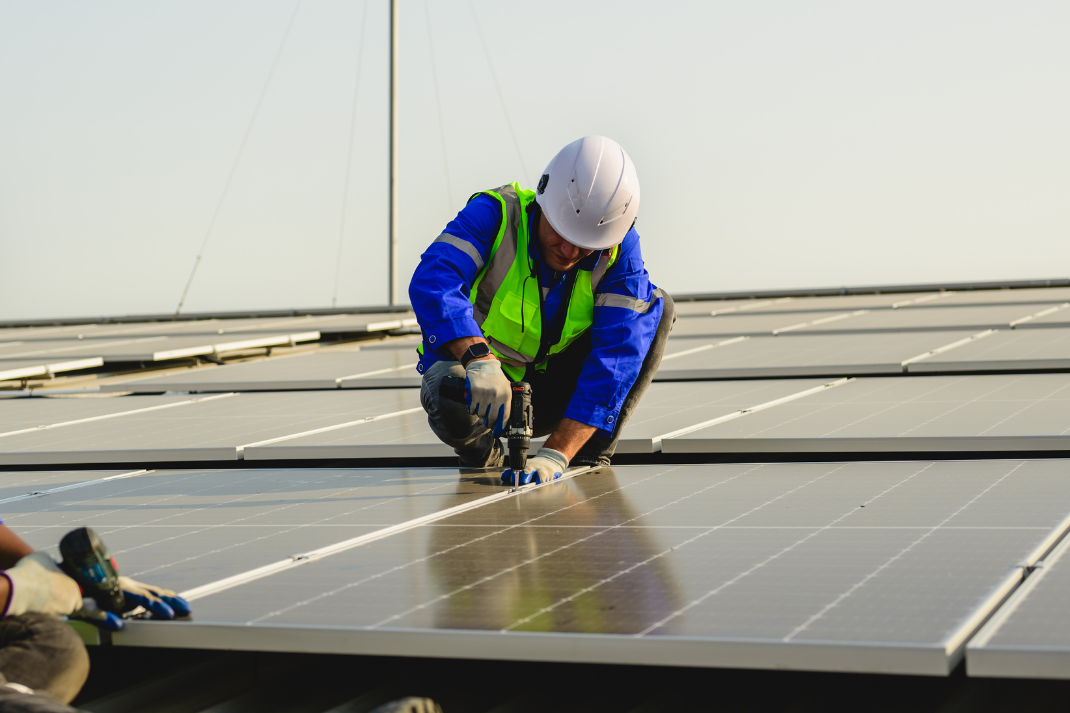
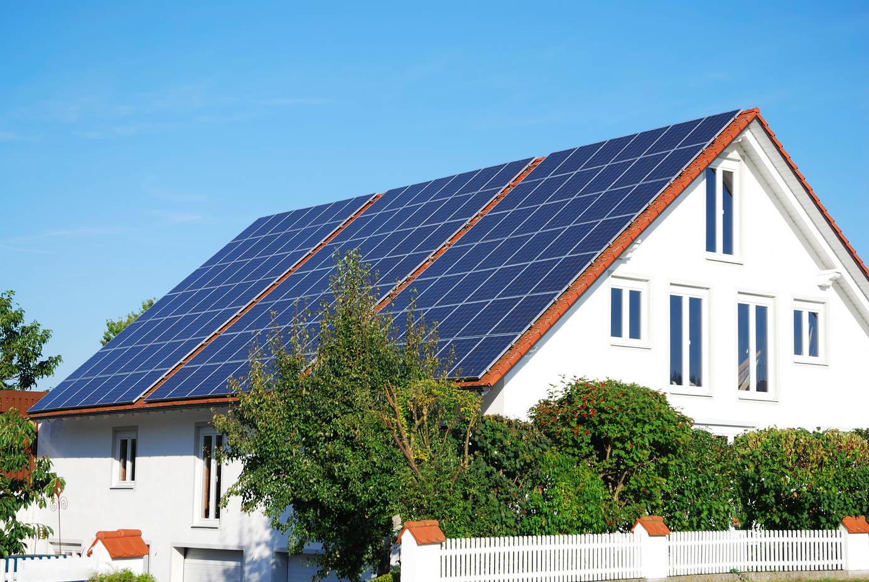
OUR COMPREHENSIVE SOLUTIONS
Solutions provide end-to-end support, from consulting to maintenance, ensuring efficient and sustainable energy systems for every client.
Energy consulting: Tailored strategies for businesses.
Installation services: End-to-end project management.
Maintenance and monitoring: Ensuring optimal performance.

Slide 9

AFFORDABLE GREEN ENERGY PACKAGES
Packages are designed to meet diverse needs, offering cost-effective solutions without compromising on quality or sustainability.
Service
Description
Price
Solar Panel Installation
Full setup for homes
$10,000 per system
Wind Turbine Setup
Small-scale wind solutions
$25,000 per unit
Energy Audit
Comprehensive efficiency review
$1,500 per site

Slide 10



GET IN TOUCH
Reach out to Arowwai Industries for expert guidance on renewable energy solutions, tailored to empower sustainable growth and innovation.
Contact Information
+123-456-7890
hello@reallygreatsite.com
123 Anywhere St., Any City, ST 12345

